Slide 1
Survey on Contrastive Self-Supervised LEarning
Anirudh Ganguly (105268071)

Slide 2
Why do we need self-supervised learning
For supervised learning tasks, the input data items need the ground truth. In certain cases we don't have data with the ground truth or have a very limited amount of data. Self-supervised learning is family of techniques that converts a unsupervised problem into a supervised problem and tries to accomplish the task.
Contrastive self-supervised learning
Contrastive learning is a discriminative approach that aims to group similar images together and group dissimilar images in different groups. In this approach, each image is first randomly augmented and then the model is trained to group the original and its augmented image together, and group the original image and the rest of the images far away

Slide 3
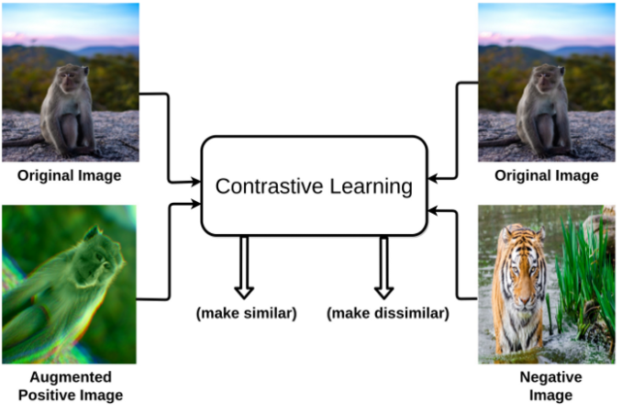
Basic intuition of contrastive learning
Source: https://arxiv.org/pdf/2011.00362.pdf

Slide 4
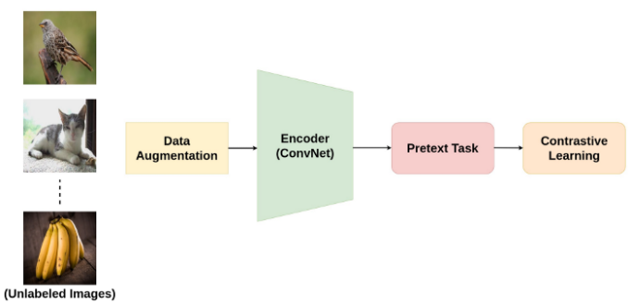
Contrastive learning pipeline
Source: https://arxiv.org/pdf/2011.00362.pdf

Slide 5
Pretext tasks
In self-supervised learning, pretext tasks refer to tasks that are used to learn representations of the data using pseudo labels. These pseudo labels are usually generated using the data attributes

Slide 6
Major groups of pretext tasks
Color Transformation
Color transformation involves basic adjustments of color levels in an image such as blurring, color distortions, converting to grayscale, etc
Geometric Transformation
Geometric transformation involves altering the basic geometry of the image without changing the actual pixel values. The transformations include scaling, random cropping, flipping, etc.
Context-Based
This approach applies to sequential data such as time-series data or a video with a series of image frames. The basic idea is to take the original data item and jumble up the sequence of frames to generate the positive sample. The rest of the data items and their transformations act as negative samples.
Cross-Model Based
This approach is also known as view prediction tasks. This is applicable for data that have multiple views of the same scene. For a given instance of time, the images from different angles of the view act as positive samples, and the images at different time-step act as negative samples.

Slide 7
Pretext tasks in NLP
Some of the pretext tasks specific to NLP are
Center and neighbor word prediction
Next sentence prediction
Auto-regressive language model
Sentence permutation

Slide 8
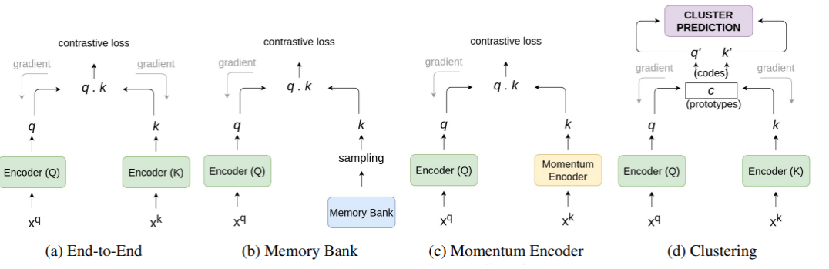
Architecture
Source: https://arxiv.org/pdf/2011.00362.pdf

Slide 9
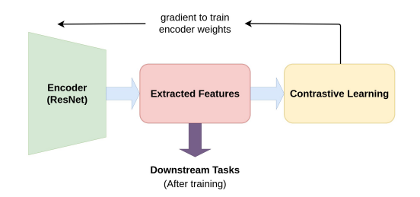
Encoders
In the context of self-supervised learning, an encoder is a network that takes the original data sample as input and outputs the representation in a latent space. These representations can be further used for downstream tasks. Depending on the problem, the output of the encoder is either upsampled or downsampled. Most of the time, ResNet-50 is used as an encoder in the literature.
Source: https://arxiv.org/pdf/2011.00362.pdf

Slide 10
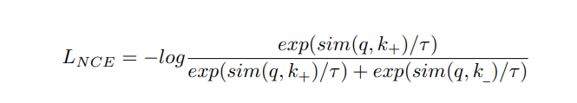
Training
To train the encoder, a pretext task utilizes contrastive loss function and backpropagates weights to update the encoder parameters. The contrastive loss behaves in such a way that the positive samples get closer in the latent space and negative samples move farther apart. Cosine similarity is commonly used as a measure of closeness between the representations. Cosine similarity can be defined as the cosine of the angle between two vectors.

Slide 11
Downstream tasks
Once the pretext task is performed in a self-supervised learning pipeline, the learning is transferred to a downstream task. Downstream tasks are application-specific tasks such as classification, segmentation, detection, etc.
The process of transferring the learnings from pretext tasks to a downstream task is called knowledge transfer and this is the central idea behind self-supervised learning.

Slide 12
Shortcomings of self-supervised learning
Lack of Theoretical Foundation
The performance of the self-supervised learning algorithm is highly dependent upon the pretext task used during the training process and the sampling scheme used. Furthermore, there is not much theoretical analysis on the different modules of self-supervised learning algorithms.
Proper Negative Samples During Training
Self-supervised contrastive learning suffers when the distance between the positive samples and negative samples is not much, resulting in a lack of contribution to the loss function. This ultimately makes the training process hard to converge. Techniques such as using a larger batch size or using a larger memory bank are used currently to deal with this problem. However such tricks increase the computational cost and complexity of the training process.
Dataset Bias
In self-supervised learning, the data itself provides supervision. Hence the learned representations are heavily influenced by the underlying training data. This makes the model less general as compared to supervised learning counterparts.

